Slide 1

Employee Database using Binary Search Tree
Present by
Praneesh.A(192571006)
Suman Raj.R(192571010)
Santha Kumar.D(192571028)
COURSE:CSA0238-Data Structure For Searching Algorithm
Guided by:
Dr.R.Jeena
Dr.M.Manikandan

Slide 2


INTRODUCTION
.
Traditional methods of storing employee information become inefficient as data grows. Searching, updating, and managing records using linear structures takes more time.
A Binary Search Tree (BST) provides an organized and faster way to store employee data based on Employee ID.
Maintains data in sorted form automatically.
Helps organizations manage large employee databases more efficiently.
Demonstrates practical application of data structures in real-world systems
To develop an organized employee database using BST.
To store, retrieve, and update employee details quickly.
To maintain employee records in sorted order.
To reduce time complexity compared to linear search methods.
To provide a scalable and easy-to-understand data management system.

Slide 3
.
PROBLEM STATEMENT
Current Challenges
Employee data is often managed manually or stored in unsorted lists.
Searching for specific employee details becomes slow and inefficient as data grows.
Updating or deleting records requires scanning the entire dataset, increasing time and effort.
Lack of a structured system leads to errors, data duplication, and difficulty in maintaining accurate records.
Inefficient data management affects decision-making and overall organizational productivity.
Need for an Automated System
An automated system is required to store employee information in a structured and organized manner.
It should allow fast search, insert, update, and delete operations.
The system must handle increasing volumes of employee data without performance loss.
Using a Binary Search Tree (BST) ensures sorted data storage and improves retrieval speed.
Automation reduces human error, improves accuracy, and enhances data management efficiency.

Slide 4
Ensuring Secure and Efficient Database Usage
PROJECT SCOPE AND OBJECTIVE
Project Scope
Automating Student, Staff, and Event Management
The system aims to automate core operations related to students, staff, and event records, reducing manual work and improving accuracy.
Providing Real-Time Information Access
The database structure allows quick retrieval of details, ensuring that users can access updated information instantly.
Ensuring Secure and Efficient Database Usage
The project focuses on maintaining data integrity, preventing unauthorized access, and ensuring smooth and efficient handling of large datasets
Project Objectives
To build an automated system that manages student, staff, and event records effectively.
To offer fast and real-time access to information using a structured data approach.
To implement a secure method for storing and handling records..

Slide 5
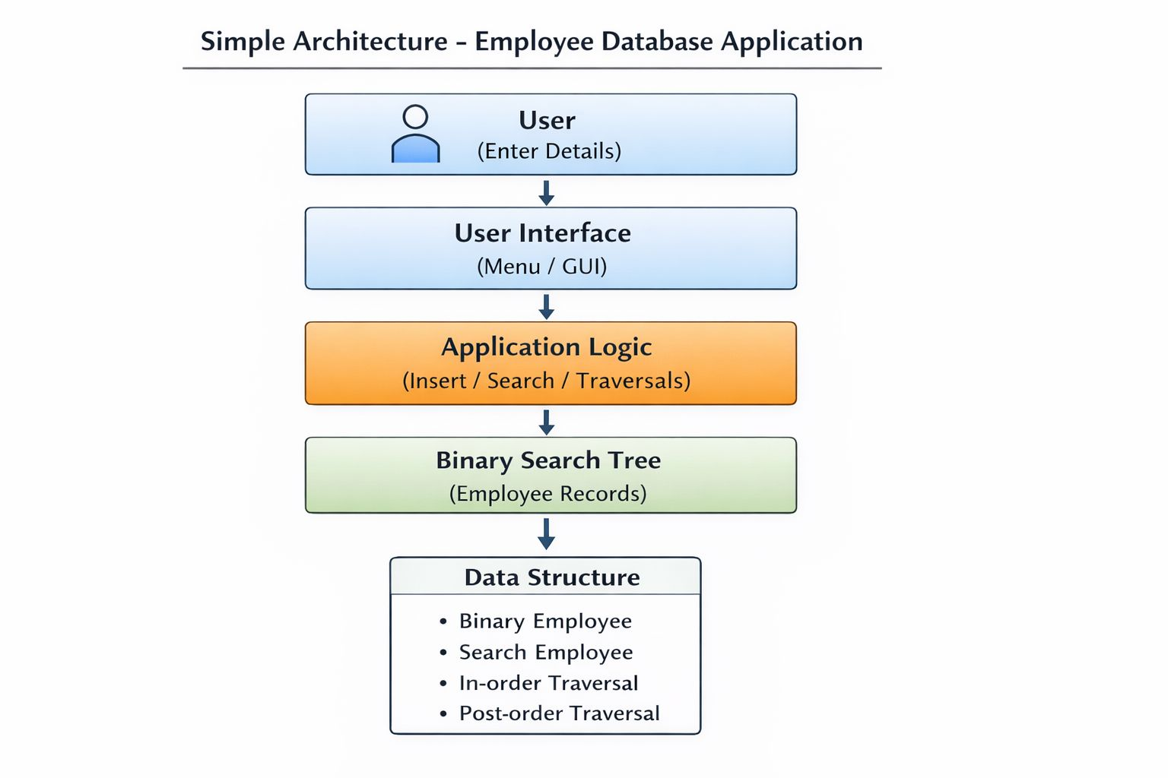
SYSTEM ARCHITECTURE

Slide 6
MODULE 1: Employee Insertion
MODULE 2: Search Module
MODULE 3: Tree Traversal

Slide 7
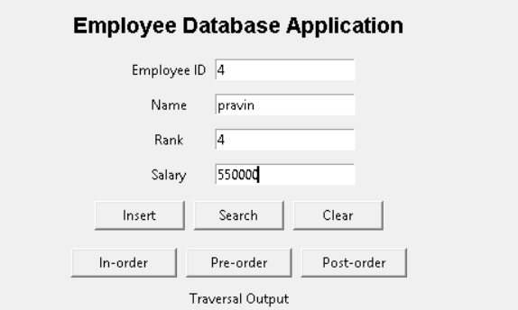
MODULE 1:
Employee Insertion
Allows adding a new employee into the system.
Employee details are inserted into the Binary Search Tree.
Ensures the database remains sorted based on Employee ID.
Prevents duplicate entries.

Slide 8
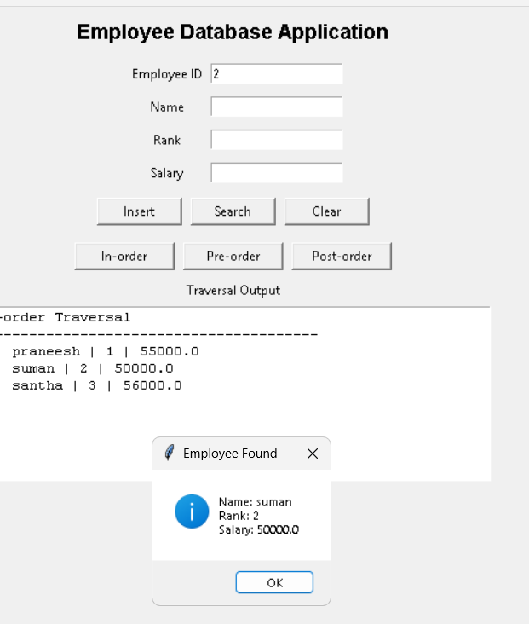
MODULE 2:Search Module
Used to find employee details quickly.
The search is based on Employee ID using BST search logic.
Traverses left or right subtrees depending on comparison results.
Displays full employee information once the record is found.
Purpose
To find if an employee exists in the BST using ID.
Key Points
If ID is found → return the employee details.
If not found → return NULL.

Slide 9
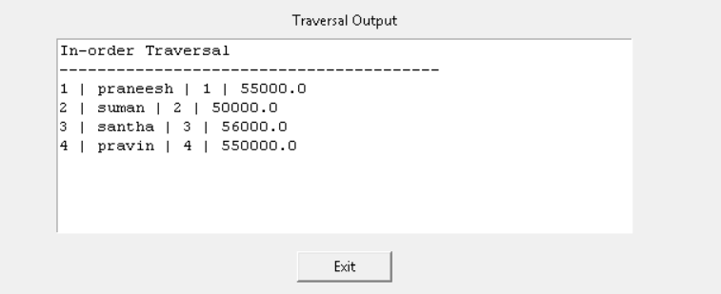
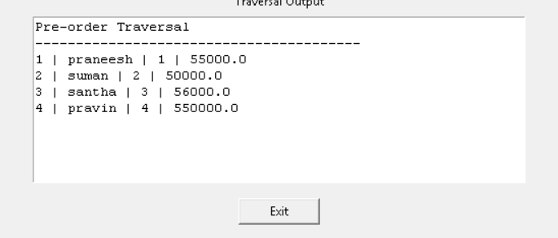
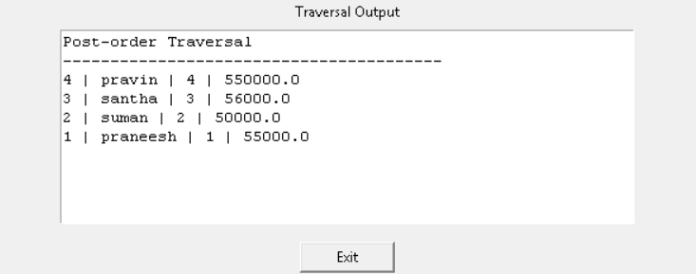
MODULE 3:Tree Traversal
Used to display all employee records in different orders.
Supports three standard BST traversal methods:
In-order Traversal
Displays employees in ascending sorted order.
Preorder Traversal
Useful for copying or saving the database structure.
Post-order Traversal
Useful for deleting nodes or analyzing the tree structure.
Provides a complete structural view of the employee database.

Slide 10
Results & Discussion
The system successfully stores employee details using a Binary Search Tree structure.
Employee insertion, search, and traversal operations work efficiently as per BST rules.
Search time significantly reduces compared to linear search methods.
In-order traversal displays employee records in sorted order based on Employee ID.
The system handles multiple employee entries without performance issues.
All three modules—Insertion, Search, Traversal—function accurately and consistently.
.

Slide 11
Challenges & Limitations
.
Challenges:
Handling large data volumes
As the number of employee records increases, tree balancing becomes more difficult.
Skewed Tree Problem
If many employee IDs are inserted in sorted order, the BST becomes skewed like a linked list, reducing efficiency.
Memory Management
Dynamic memory allocation and freeing nodes correctly is challenging and prone to errors in implementations.
Limitations:
Performance Depends on Tree Shape
BST operations are fast only when the tree is balanced; unbalanced trees increase time complexity to O(n).
Lack of Database Features
No support for advanced features like indexing, transactions, or concurrency found in real databases.
Limited Security
Basic BST structure does not offer built-in security or encryption for sensitive employee data.
.

Slide 12
CONCLUSION
The Employee Database system using a Binary Search Tree successfully demonstrates how data structures can be applied to efficiently manage organizational records.
The BST approach provides faster insertion, searching, and traversal compared to linear data storage methods.
By maintaining employee records in a sorted structure, the system ensures quick access and better data organization.
The project achieves its objectives by automating employee management and improving data retrieval performance.
Although the system has limitations such as dependency on tree balance, it still serves as an effective and scalable solution for small to medium-sized databases.
Overall, the project highlights the importance of structured data management and demonstrates how BSTs can simplify real-world record-handling tasks.

Slide 13
REFERENCE
Horowitz, E., Sahni, (2025)S., & Anderson-Freed, S. Fundamentals of Data Structures in C. University Press.
Weiss, M. A.(2024) Data Structures and Algorithm Analysis in C. Pearson Education.
Kruse, R., Leung, B., & Tondo,(2024) C. Data Structures and Program Design in C. Pearson.
Aho, A. V., Hopcroft, J. E., & Ullman, J. (2023)D. Data Structures and Algorithms. Addison-Wesley.
Cormen, T. H., Leiserson, C. E., Rivest, R. L., & Stein, (2025)C. Introduction to Algorithms. MIT Press.
Yedidyah Langsam, Augenstein, M. J., & Tenenbaum, A. M.(2024)Data Structures Using C and C++. Pearson.
Lalit, K.(2025)Data Structures Through C in Depth. BPB Publications.
Geeks for Geeks.(2023)Binary Search Tree – Concepts and Implementation.
Tutorials Point.(2025) Data Structures & Algorithms – Binary Search Tree.
IEEE Xplore Digital Library.(2025) Research Articles on Efficient Tree-Based Data Management Systems.

Slide 14
THANK YOU

